Slide 1
Active Learning of Ocean Currents with Drifters via BALLAST
Rui-Yang Zhang
https://shusheng3927.github.io/
13th February 2025
UCL Statistics PhD Seminar

Slide 2
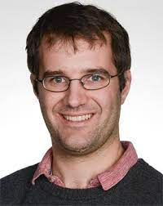
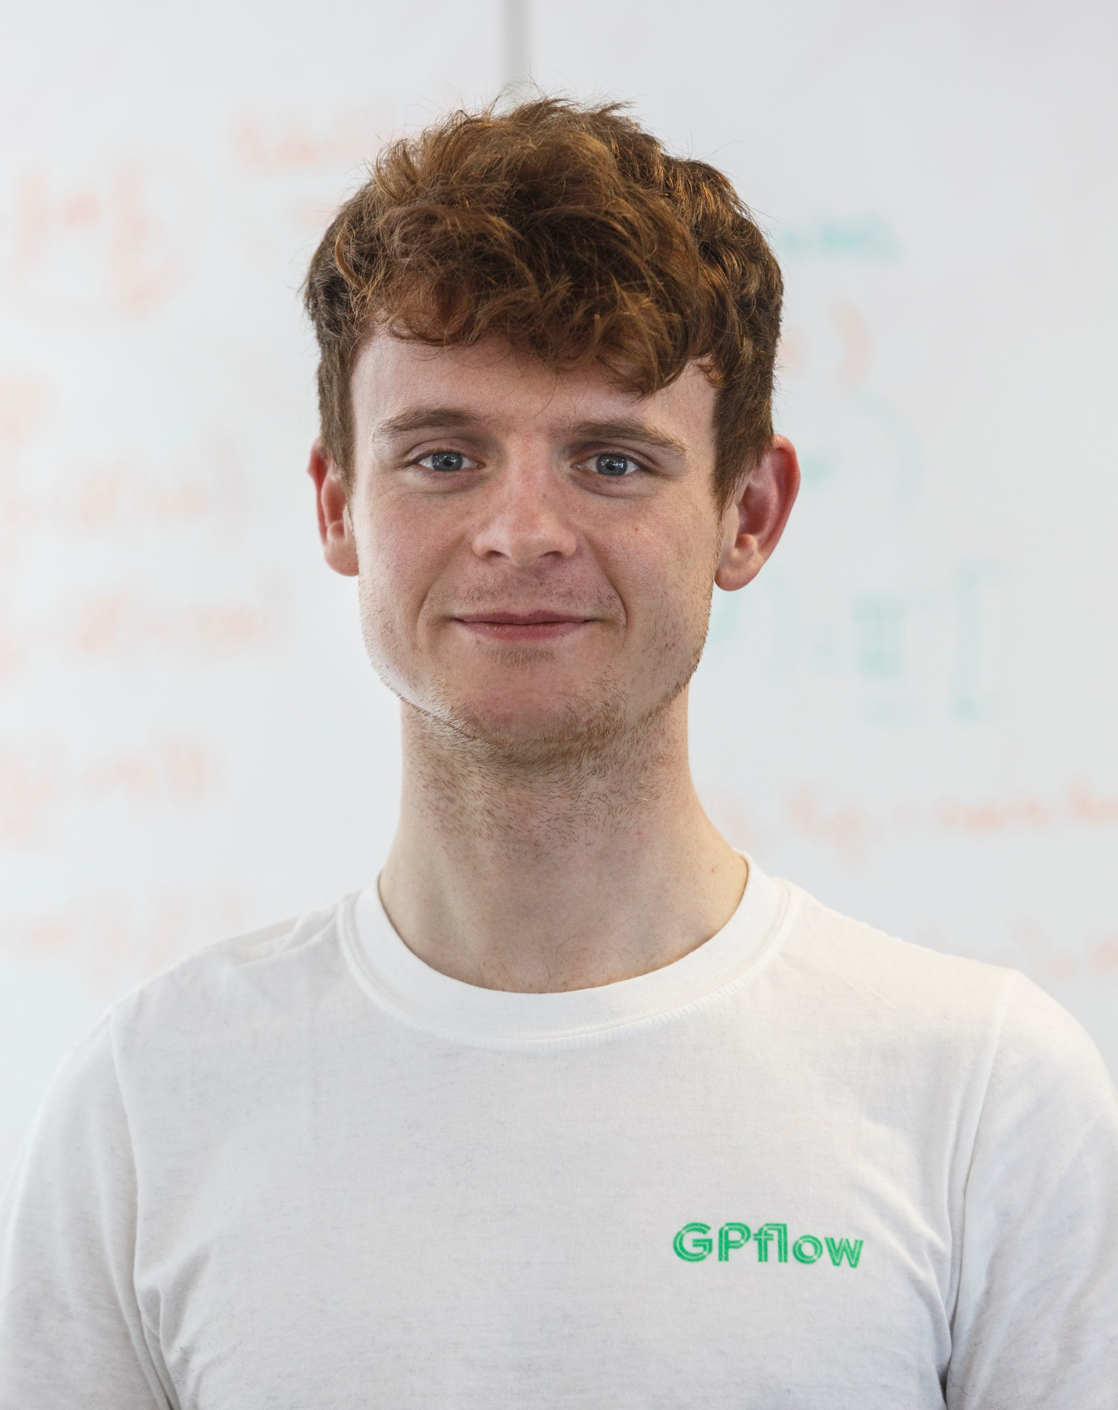
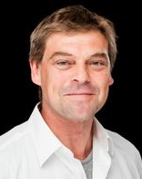
Supervisors
David Leslie
Henry Moss
Ed Cripps
Lachlan Astfalck

Slide 3
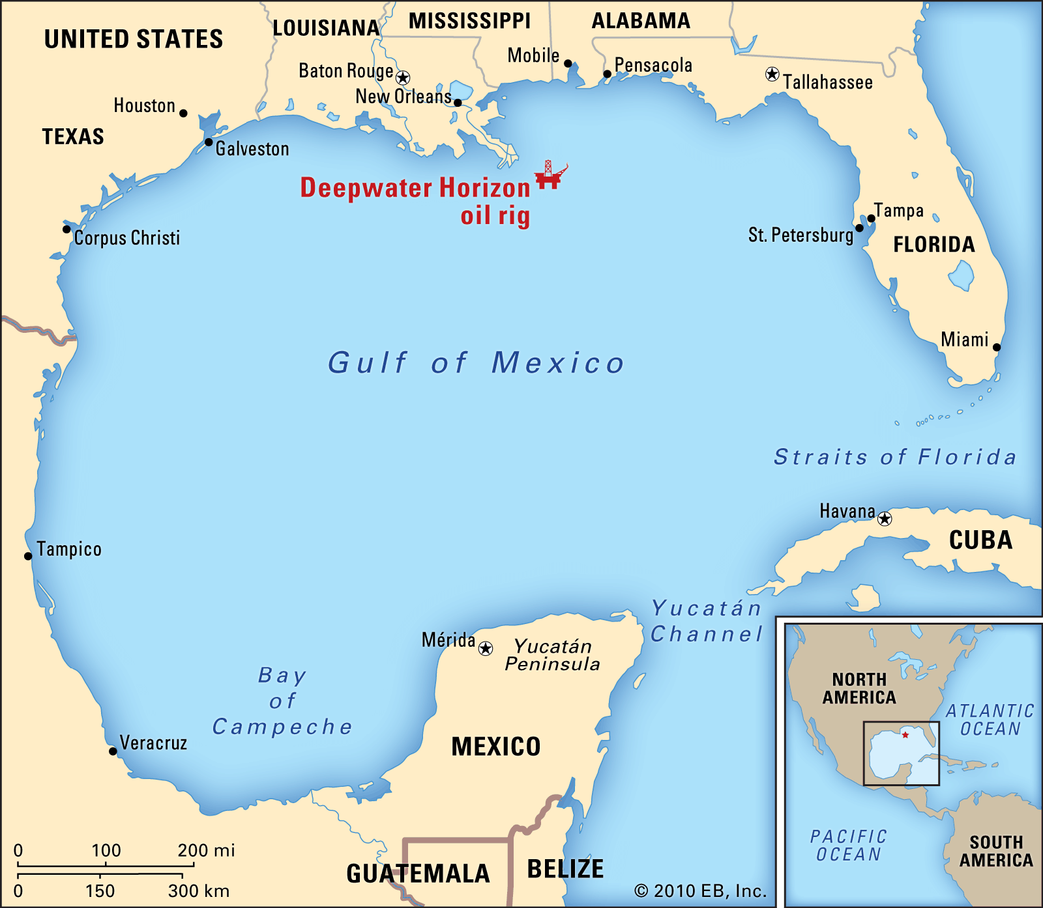
Gulf of Mexico
Source: https://www.britannica.com/place/Gulf-of-Mexico

Slide 4
Gulf of Mexico
Source: https://www.britannica.com/place/Gulf-of-Mexico

Slide 5
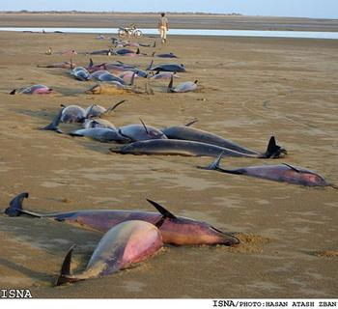
Deepwater Horizon Oil Spill (April 2010)
Source: https://blog.cabi.org/2011/05/06/deepwater-horizon-oil-spill-one-year-on-how-have-birds-and-marine-life-been-affected/
Source: https://www.newyorker.com/magazine/2011/03/14/the-gulf-war

Slide 6
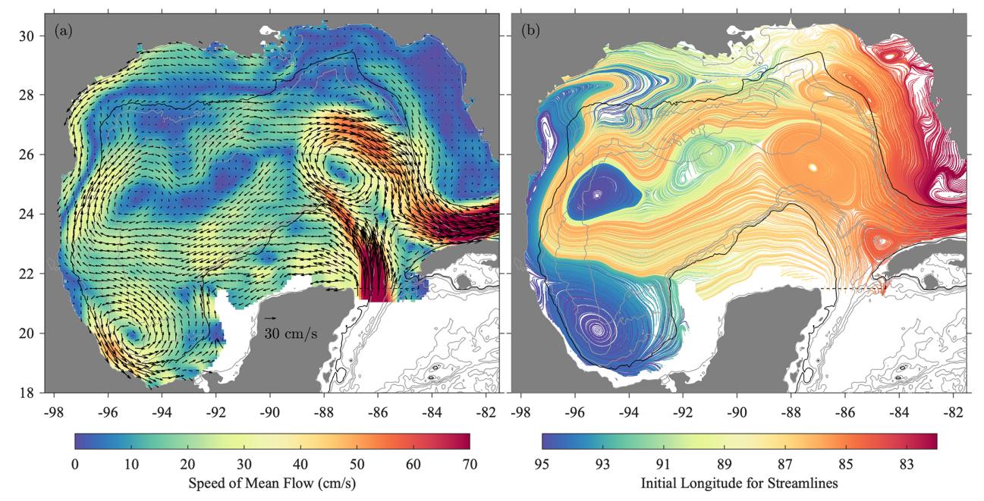
Modelling Currents
Source: Lilly, J. M. and Perez-Brunius, P. (2021). A gridded surface current product for the Gulf of Mexico
from consolidated drifter measurements, Earth System Science Data 13(2): 645–669.

Slide 7
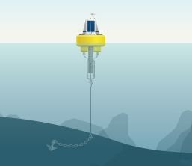
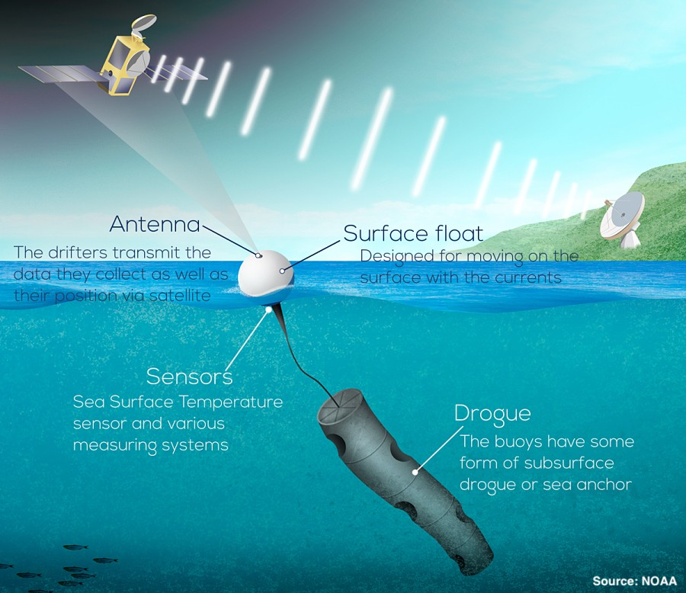
Measuring Devices
Mooring Buoy (Eulerian)
Drogued Drifter (Lagrangian)
Source: https://www.fondriest.com/environmental-measurements/monitoring-equipment/buoy-mooring/
Source: https://www.aoml.noaa.gov/global-drifter-program/

Slide 8
Measuring Devices
$$$
$
Mooring Buoy (Eulerian)
Drogued Drifter (Lagrangian)
Source: https://www.fondriest.com/environmental-measurements/monitoring-equipment/buoy-mooring/
Source: https://www.aoml.noaa.gov/global-drifter-program/

Slide 9
Measuring Devices
$$$
$
Mooring Buoy (Eulerian)
Drogued Drifter (Lagrangian)
Source: https://www.fondriest.com/environmental-measurements/monitoring-equipment/buoy-mooring/
Source: https://www.aoml.noaa.gov/global-drifter-program/

Slide 10
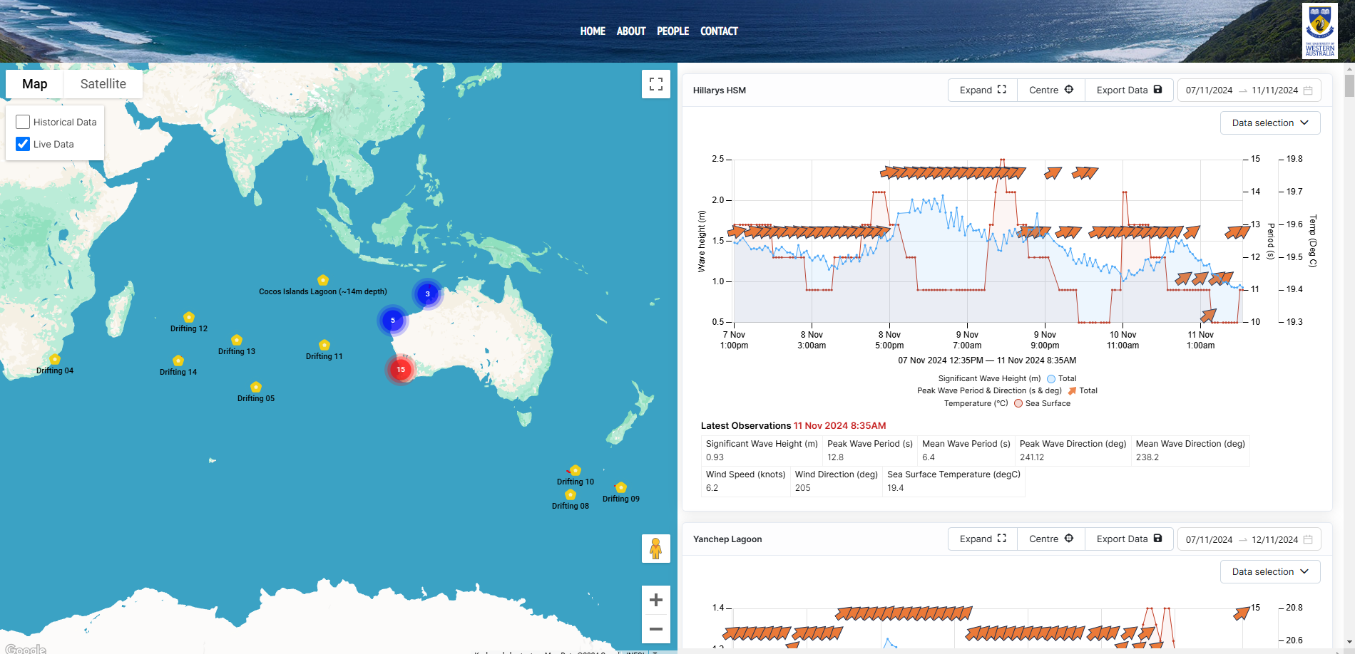
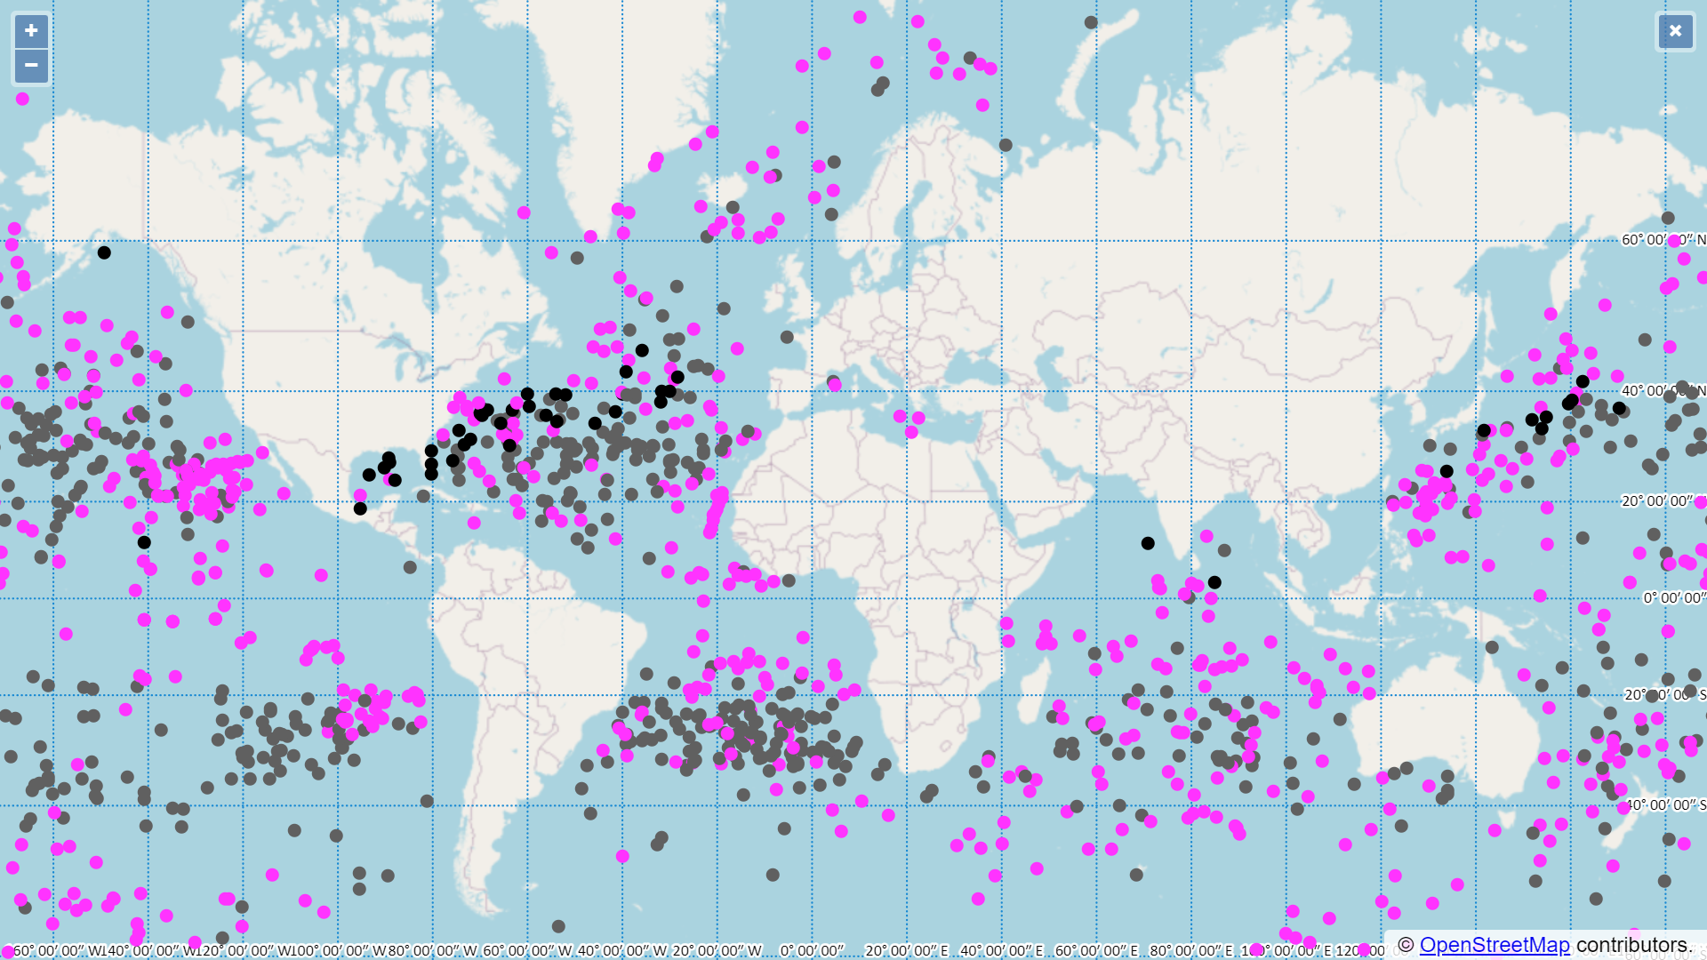
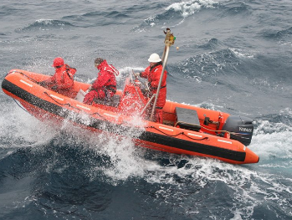
Current Practice
Source: https://wawaves.org/
Source: https://www.aoml.noaa.gov/phod/gdp/interactive/drifter_array.html

Slide 11
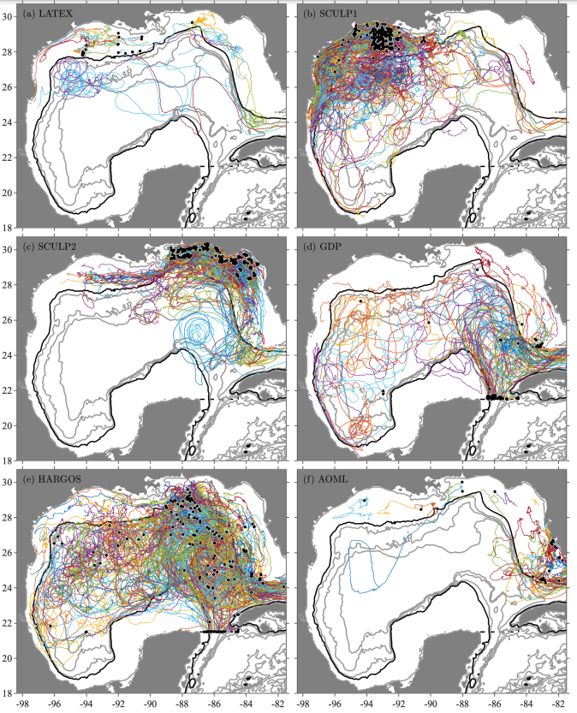
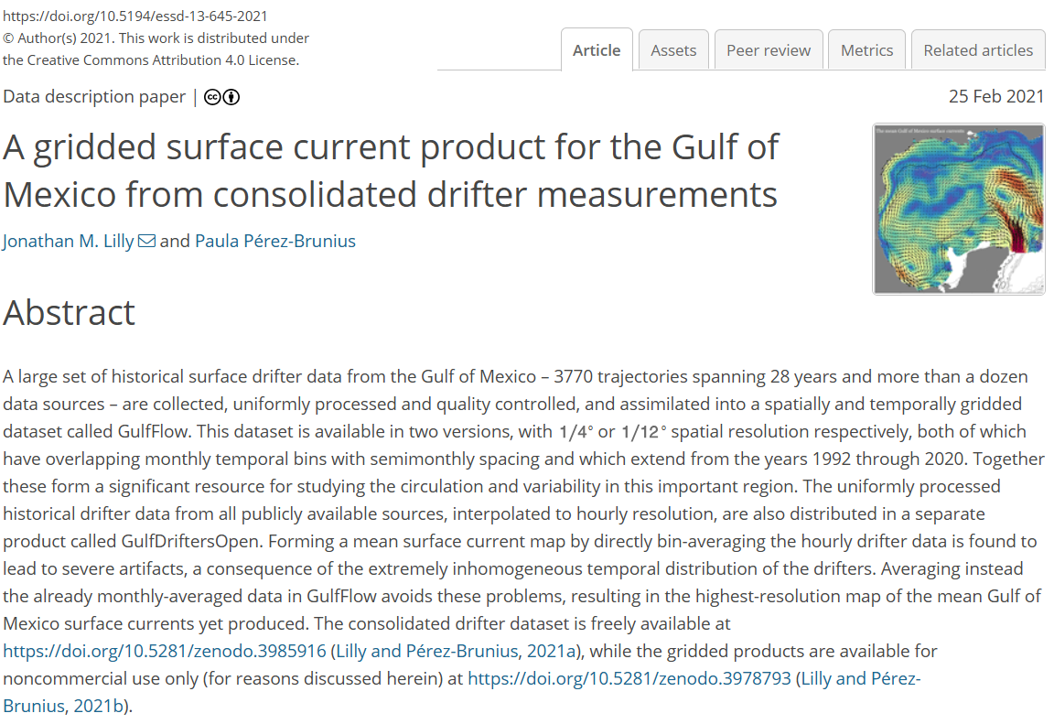
Current Practice
Source: Lilly, J. M. and Perez-Brunius, P. (2021). A gridded surface current product for the Gulf of Mexico from consolidated drifter measurements, Earth System Science Data 13(2): 645–669.

Slide 12
What’s The Problem?

Slide 13
What’s The Problem?

Slide 14
What’s The Problem?

Slide 15
What’s The Problem?
All data are informative,
but some are more informative than others.

Slide 16
Experiment Design
Which data should we observe?

Slide 17
Experiment Design
Which data should we observe?
Model-Agnostic
Random
Space-filling
Model-Based
Ad-Hoc
Active Learning

Slide 18
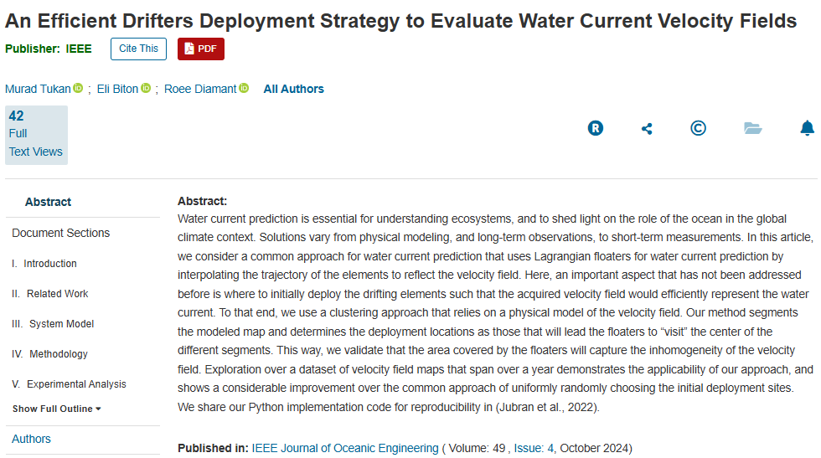
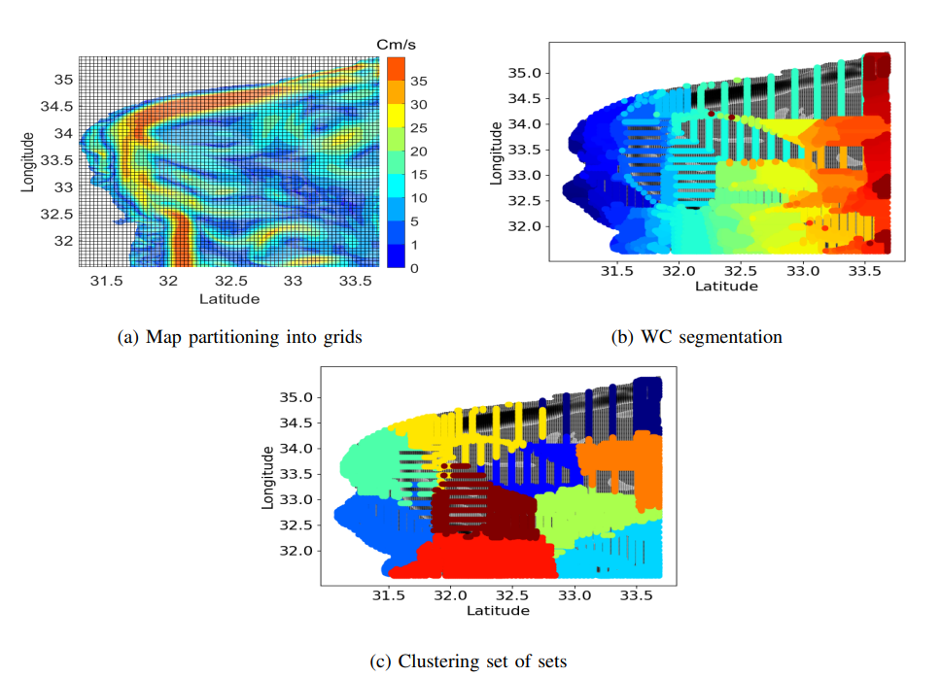
Experiment Design
Which data should we observe?
Model-Agnostic
Random
Space-filling

Slide 19
Experiment Design
Which data should we observe?
Model-Agnostic
Random
Space-filling
Model-Based
Ad-Hoc
Active Learning

Slide 20
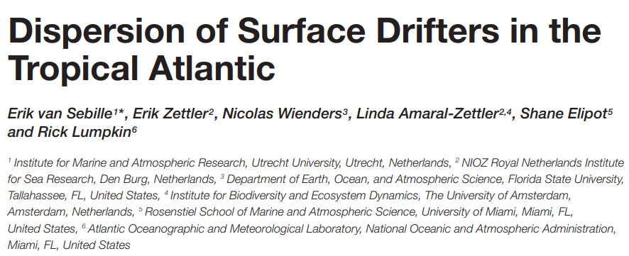
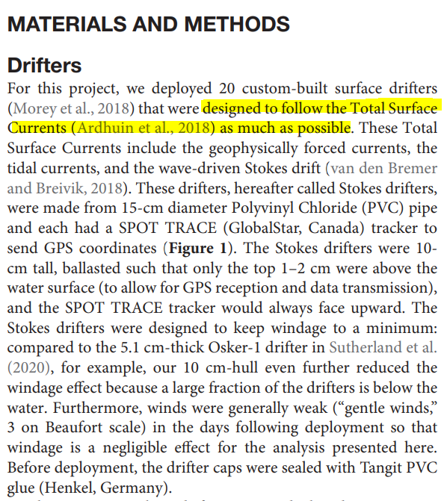
Experiment Design
Which data should we observe?
Model-Agnostic
Random
Space-filling
Model-Based
Ad-Hoc
Active Learning

Slide 21
Experiment Design
Which data should we observe?
Model-Agnostic
Random
Space-filling
Model-Based
Ad-Hoc
Active Learning
use existing data to guide future observations

Slide 22
Sequential Experiment Design
e.g. Active Learning

Slide 23
Sequential Experiment Design
e.g. Active Learning
POTENTIAL OBSERVATIONS
CURRENT
DATA

Slide 24
Sequential Experiment Design
e.g. Active Learning
POTENTIAL OBSERVATIONS
CURRENT
DATA
UPDATE
MODEL

Slide 25
Sequential Experiment Design
e.g. Active Learning
POTENTIAL OBSERVATIONS
CURRENT
DATA
UPDATE
MODEL
EVALUATE
NEXT OBSERVATION

Slide 26
Sequential Experiment Design
e.g. Active Learning
OBSERVE
POTENTIAL OBSERVATIONS
QUERY
CURRENT
DATA
UPDATE
MODEL
EVALUATE
NEXT OBSERVATION

Slide 27
Sequential Experiment Design
e.g. Active Learning
OBSERVE
POTENTIAL OBSERVATIONS
QUERY
CURRENT
DATA
UPDATE
MODEL
EVALUATE
NEXT OBSERVATION
GP Regression
Acquisition Function

Slide 28
Model & Data

Slide 29
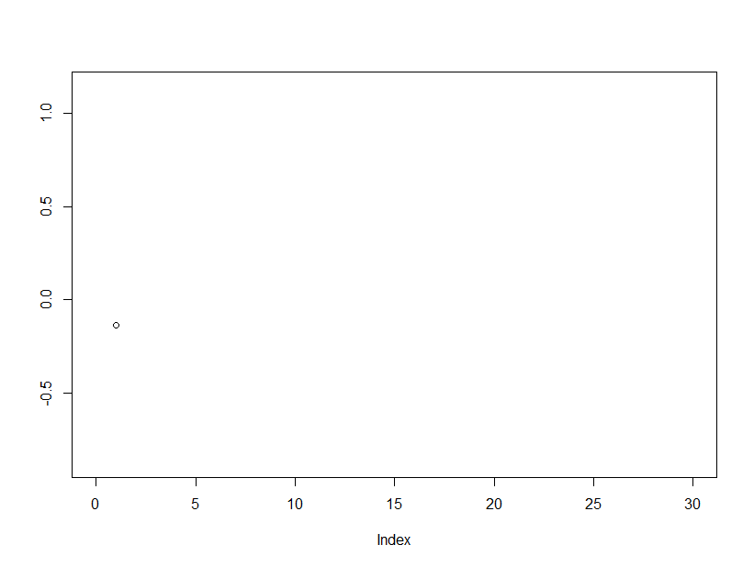
Introduction to Gaussian Process
Multivariate Gaussian Centred, Correlated Horizontally Displayed

Slide 30
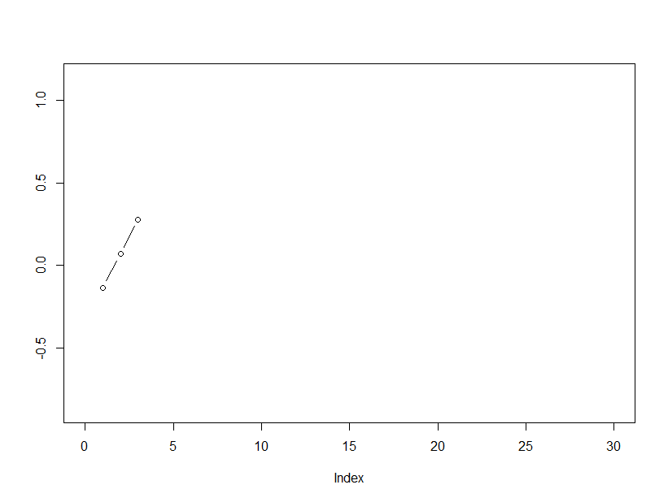
Introduction to Gaussian Process
Multivariate Gaussian Centred, Correlated Horizontally Displayed

Slide 31
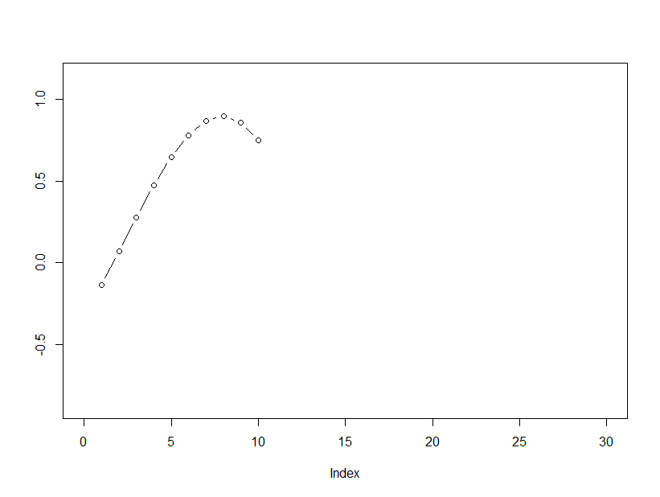
Introduction to Gaussian Process
Multivariate Gaussian Centred, Correlated Horizontally Displayed

Slide 32
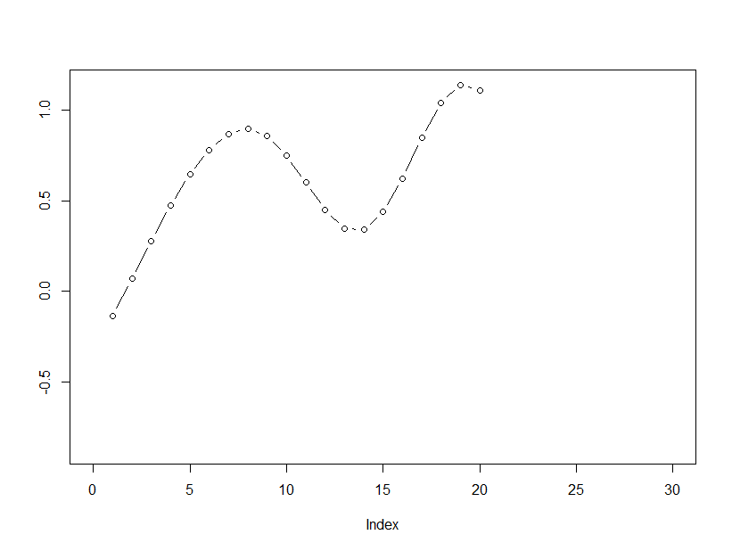
Introduction to Gaussian Process
Multivariate Gaussian Centred, Correlated Horizontally Displayed

Slide 33
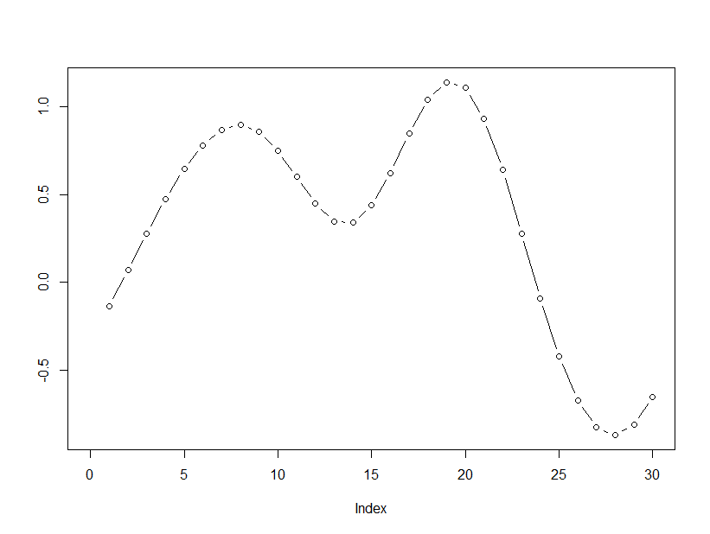
Introduction to Gaussian Process
Multivariate Gaussian Centred, Correlated Horizontally Displayed

Slide 34
Introduction to Gaussian Process

Slide 35
Introduction to Gaussian Process
often set to zero for simplicity
key design choice!!

Slide 36
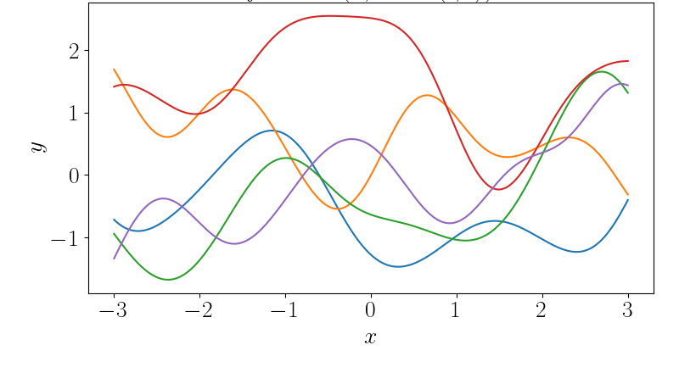
Introduction to Gaussian Process
Source: https://andrewcharlesjones.github.io/menu/blog.html
often set to zero for simplicity
key design choice!!
Squared Exponential (SE) Kernel

Slide 37
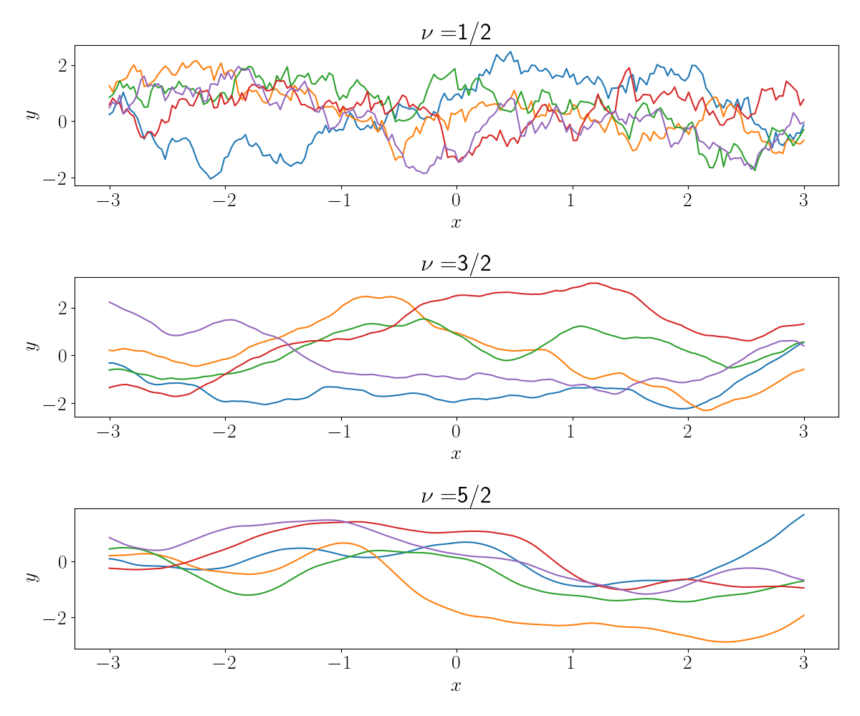
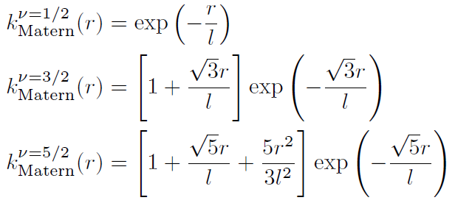
Introduction to Gaussian Process
Source: https://andrewcharlesjones.github.io/menu/blog.html
often set to zero for simplicity
key design choice!!
Matern Kernel

Slide 38
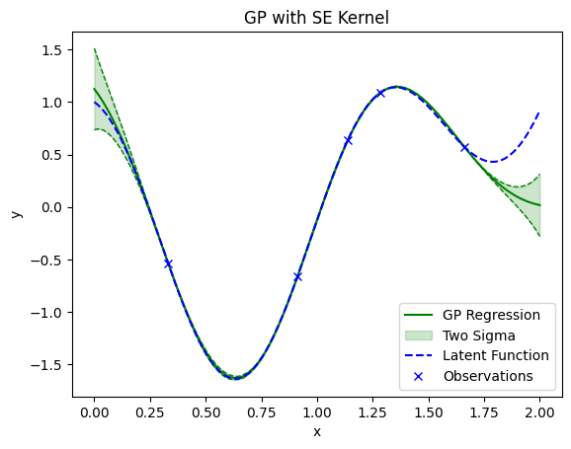
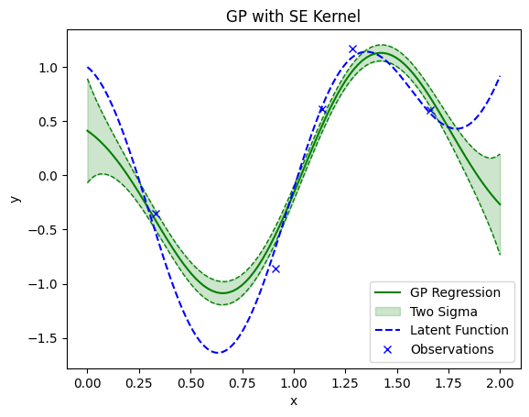
Introduction to Gaussian Process
Regression with Exact Observations
Regression with Noisy Observations

Slide 39
Wait … but we want to generate a vector field!

Slide 40
From Scalar to Vector
$$F= \left[\begin{matrix}u \\ v\end{matrix}\right]$$
2D Vector Field

Slide 41
From Scalar to Vector
$$F= \left[\begin{matrix}u \\ v\end{matrix}\right]$$
$$\left[\begin{matrix} \text{Gaussian} \text{Process}\text{ 1 } \\ \text{Gaussian} \text{Process}\text{ 2 }\end{matrix}\right]$$
2D Vector Field

Slide 42
From Scalar to Vector
$$F= \left[\begin{matrix}u \\ v\end{matrix}\right]$$
$$\left[\begin{matrix} \text{Gaussian} \text{Process}\text{ 1 } \\ \text{Gaussian} \text{Process}\text{ 2 }\end{matrix}\right]$$
2D Vector Field
Sure, but how about the correlation?

Slide 43
From Scalar to Vector
$$F= \left[\begin{matrix}u \\ v\end{matrix}\right]$$
$$\left[\begin{matrix} \text{Gaussian} \text{Process}\text{ 1 } \\ \text{Gaussian} \text{Process}\text{ 2 }\end{matrix}\right]$$
2D Vector Field
Sure, but how about the correlation?
Method 1: Ignore → Velocity Decomposition

Slide 44
From Scalar to Vector
$$F= \left[\begin{matrix}u \\ v\end{matrix}\right]$$
$$\left[\begin{matrix} \text{Gaussian} \text{Process}\text{ 1 } \\ \text{Gaussian} \text{Process}\text{ 2 }\end{matrix}\right]$$
2D Vector Field
Sure, but how about the correlation?
Method 1: Ignore → Velocity Decomposition
Method 2: Transform → Helmholtz Decomposition

Slide 45
Helmholtz Model
Model separately

Slide 46
Helmholtz Model
Model separately
Overall kernel

Slide 47
Helmholtz Model
Model separately
Overall kernel

Slide 48
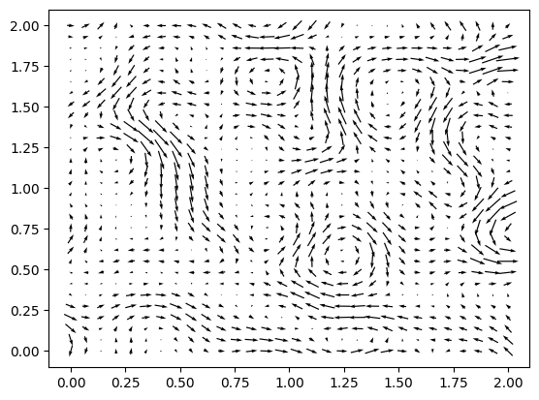
Helmholtz-GP Model
Gaussian Process model for vector fields
Model divergence and curl of the field separately
Incorporate data easily – conjugate posterior
Natural uncertainty quantification

Slide 49
Helmholtz-GP Model

Slide 50
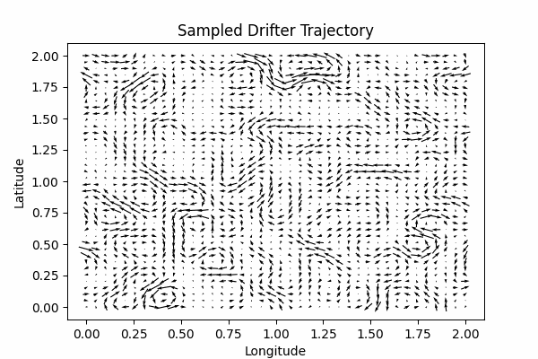
Data: Drifter Trajectories
Continuously move
Following vector field
Multiple observations

Slide 51
Active Learning

Slide 52
Bayesian Active Learning

Slide 53
Bayesian Active Learning
Prior
Likelihood
Posterior

Slide 54
Bayesian Active Learning
Prior
Likelihood
Posterior
Current Belief
New Data
Updated Belief

Slide 55
Bayesian Active Learning
Prior
Likelihood
Posterior
Current Belief
New Data
Updated Belief
Where should we observe to maximise our “information”?

Slide 56
Bayesian Active Learning
Potential Observation
Potential Observation
Potential Observation
Potential Observation

Slide 57
Bayesian Active Learning
Current Model
Potential Observation
Potential Observation
Current Data
Potential Observation
Potential Observation
Utility Function

Slide 58
Bayesian Active Learning
Current Model
Potential Observation
Potential Observation
Current Data
Optimal Observation
Potential Observation
Potential Observation
Utility Function

Slide 59
Bayesian Active Learning
Current Model
Potential Observation
Potential Observation
Current Data
Optimal Observation
Potential Observation
Potential Observation
Utility Function
Query

Slide 60
Utility Choices
Utility should reflect the quality of the potential observation w.r.t. our goal.

Slide 61
Utility Choices
Utility should reflect the quality of the potential observation w.r.t. our goal.
Goal: Learn an unknown function, maximise our “information”
Utility Choices
Maximum Variance
Maximum Integrated Variance
Max Var: Measure at the point where our latest model has the highest variance
Max Integrated Var: Measure at the point where our latest model has the least total variance if we know the point’s value

Slide 62
Maximum Variance
Max Var: Measure at the point where our latest model has the highest variance

Slide 63
Maximum Integrated Variance
Max Int. Var: Measure at the point where our latest model has the least total variance if we know the point’s value

Slide 64
Myopic Policies
only consider the immediate observation
Sequential Experiment Design / Active Learning is Myopic.
Is this a problem?

Slide 65
Myopic Policies
only consider the immediate observation
Sequential Experiment Design / Active Learning is Myopic.
Would be sensible to incorporate the future observations of a drifter…

Slide 66
BALLAST

Slide 67
Our Problem
We need a policy that
Incorporates future observations of a placed drifter
Respects drifter trajectory structure
Avoids too much computational cost

Slide 68
Our Problem
We need a policy that
Incorporates future observations of a placed drifter
Respects drifter trajectory structure
Avoids too much computational cost
We propose
BALLAST: Bayesian Active Learning with Look-ahead Amendment for Sea-drifter Trajectories

Slide 69
BALLAST
Still only consider the initial position
Construct look-ahead using trajectory projections
Compute utility using all projected observations

Slide 70
BALLAST
Still only consider the initial position
Construct look-ahead using trajectory projections
Compute utility using all projected observations
constructed look-ahead
only consider the initial position
utility computed with all projected observations

Slide 71
BALLAST
Projection Construction
Field approximation $\hat{F}$
Euler discretisation
Step number $T$
Step size $δ$

Slide 72
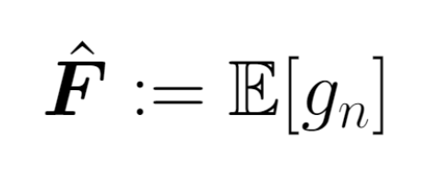
BALLAST
Projection Construction
Field approximation $\hat{F}$
Euler discretisation
Step number $T$
Step size $δ$
Field Approximation
BALLASTn model average

Slide 73
BALLAST
Projection Construction
Field approximation $\hat{F}$
Euler discretisation
Step number $T$
Step size $δ$
Field Approximation
BALLASTn model average
BALLASTs sample average

Slide 74
BALLAST
Projection Construction
Field approximation $\hat{F}$
Euler discretisation
Step number $T$
Step size $δ$
Field Approximation
BALLASTn model average
BALLASTs sample average

Slide 75
BALLAST
Projection Construction
Field approximation $\hat{F}$
Euler discretisation
Step number $T$
Step size $δ$
Field Approximation
BALLASTn model average
BALLASTs sample average

Slide 76
Sequential Experiment Design
e.g. Active Learning
OBSERVE
POTENTIAL OBSERVATIONS
QUERY
CURRENT
DATA
UPDATE
MODEL
EVALUATE
NEXT OBSERVATION
GP Regression
Acquisition Function

Slide 77
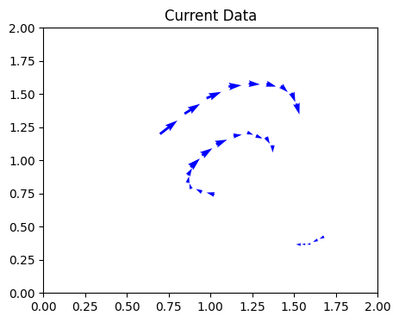
Active Learning
CURRENT
DATA

Slide 78
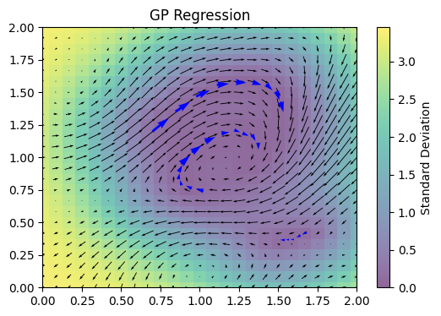
Active Learning
CURRENT
DATA
UPDATE
MODEL
GP Regression

Slide 79
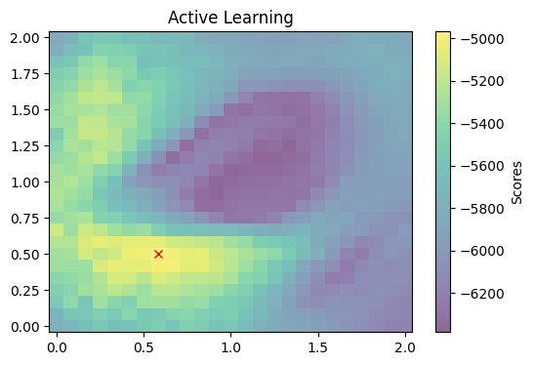
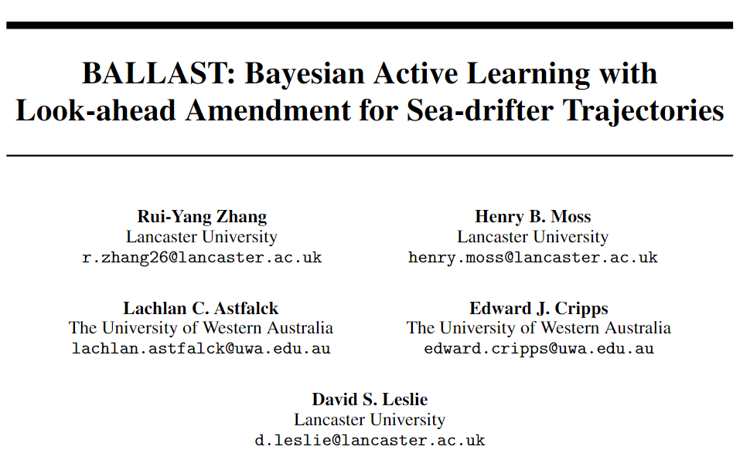
Active Learning
Integrated Var + BALLAST
CURRENT
DATA
UPDATE
MODEL
EVALUATE
NEXT OBSERVATION
GP Regression
Acquisition Function

Slide 80
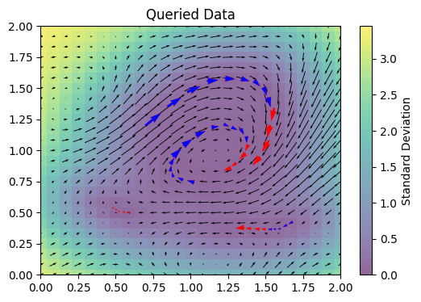
Active Learning
OBSERVE
POTENTIAL OBSERVATIONS
QUERY
CURRENT
DATA
UPDATE
MODEL
EVALUATE
NEXT OBSERVATION
GP Regression
Acquisition Function

Slide 81
BALLASTs + Max Int. Var

Slide 82
Simulation

Slide 83
Experiment Setup
Ground field generated from the Helmholtz kernel
8 drifters are sequentially placed
When a drifter leaves the region, it’s terminated

Slide 84
Experiment Setup
Ground field generated from the Helmholtz kernel
8 drifters are sequentially placed
When a drifter leaves the region, it’s terminated
100 different starting seeds
8 policies considered:
uniform sampling
Sobol sequence
max var
max var + BALLASTn
max var + BALLASTs with 100 samples
max integrated var
max integrated var + BALLASTn
max integrated var + BALLASTs with 100 samples.

Slide 85
Experiment Setup
Performance Metrics
Mean squared error of predictive mean
Predictive standard deviation
Ground field generated from the Helmholtz kernel
8 drifters are sequentially placed
When a drifter leaves the region, it’s terminated
100 different starting seeds
8 policies considered:
uniform sampling
Sobol sequence
max var
max var + BALLASTn
max var + BALLASTs with 100 samples
max integrated var
max integrated var + BALLASTn
max integrated var + BALLASTs with 100 samples.

Slide 86
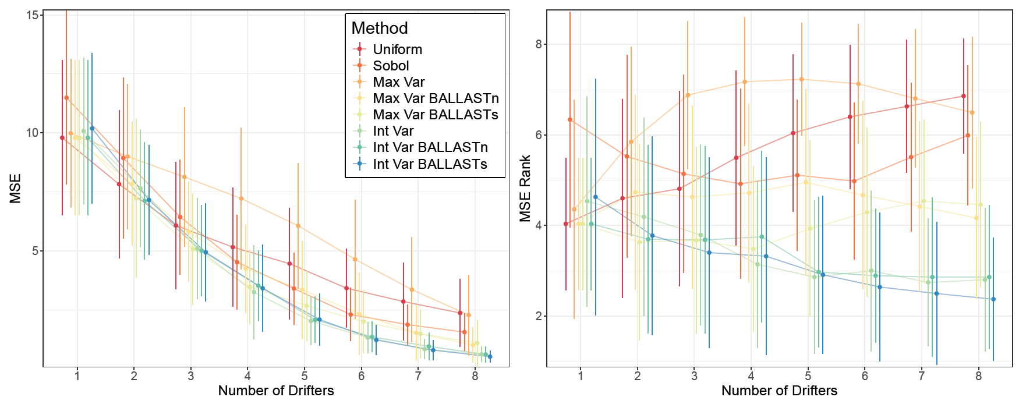
Experiment Results – MSE

Slide 87
Experiment Results
BALLAST amendments uniformly improve, regardless of the base utility.
The improvement is more significant with more placed drifters.
Simple policy (e.g. maximum variance) after BALLAST amendments is comparable to advanced policy (e.g. integrated variance).

Slide 88
Future Research
More experiments with risk-averse and information-theoretic base policies.
Consider time-varying vector fields and consider placement times.
Incorporate drifter placement costs and consider cost-aware active learning.

Slide 89
https://shusheng3927.github.io/research.html

